Slide 1

Extremely Hot and Incredibly Crowded: heat-illness risk in New York City's busiest MTA stations
Hannah Lewis
Metis, EDA Module
July 23, 2021
Notes:
I would like to present to you my work in developing an interactive map that can be used to assess heat-illness risk at each of New York City’s subway stations.

Slide 2
Overview
Motivation
NYC Department of Health wants to compile a list of MTA stations that pose the greatest health hazard to people at high-risk for heat-related illnesses
Results
Interactive map to find high-risk stations and to search for nearby stations with lower risk indices
Objectives
Determine:
(1) the most crowded stations,
(2) the hottest stations,
(3) the highest risk stations due to the combined impact of these factors
Notes:
So first, our motivation is that for an upcoming press release concerning summer heat, the New York City Department of Health wants to compile a list of MTA stations that pose the greatest hazard—due to the combination of high heat and large crowds—to people at high-risk for heat-related illnesses. Though high heat is the primary cause of heat stress, being in densely crowded areas can exacerbate heat stress.

Slide 3
Overview
Motivation
NYC Department of Health wants to compile a list of MTA stations that pose the greatest health hazard to people at high-risk for heat-related illnesses
Results
Interactive map to find high-risk stations and to search for nearby stations with lower risk indices
Objectives
Determine:
(1) the most crowded stations,
(2) the hottest stations,
(3) the highest risk stations due to the combined impact of these factors
Notes:
Our objectives then are to determine the most crowded stations and the hottest stations. Now, this second objective relies on the assumption that the temperature inside each station is approximately equal to the temperature outside. Though the subway cars themselves are airconditioned, the stations generally are not, so this is likely a safe assumption.

Slide 4
Overview
Motivation
NYC Department of Health wants to compile a list of MTA stations that pose the greatest health hazard to people at high-risk for heat-related illnesses
Results
Interactive map to find high-risk stations and to search for nearby stations with lower risk indices
Objectives
Determine:
(1) the most crowded stations,
(2) the hottest stations,
(3) the highest risk stations due to the combined impact of these factors
Notes:
We then want to combine those two factors—crowds and heat—to determine which stations pose the greatest risk for heat-illnesses.

Slide 5
Overview
Motivation
NYC Department of Health wants to compile a list of MTA stations that pose the greatest health hazard to people at high-risk for heat-related illnesses
Objectives
Determine:
(1) the most crowded stations,
(2) the hottest stations,
(3) the highest risk stations due to the combined impact of these factors
Results
Interactive map to find high-risk stations and to search for nearby stations with lower risk indices
Notes:
Through this analysis, we’ve produced a list of high-risk stations, and an interactive map which passengers can use to explore nearby stations with lower risk for heat-related illnesses.

Slide 6






Data & Methods
MTA turnstile data
Join with spatial data, clean, calculate net entries for each station
Derive
crowd index
Notes:
Very quickly, stepping through our data analysis workflow.
The MTA transit data of interest, which consists of three months of data spanning the summer of 2018, exists in an SQL database, and we use SQLAlchemy to communicate with that database from a python script. We join that database with a new table containing spatial coordinates for each MTA station, and then clean that data using pandas in python.
We then calculate the total entries recorded over the observed time period for each station. That total entries number is then converted into what we’ve called a “crowd index”.

Slide 7





Data & Methods
MTA turnstile data
Join with spatial data, clean, calculate net entries for each station
Derive
crowd index
NASA Landsat 8 satellite image
Extract median surface temperature on each city block
Derive
heat index
Notes:
To determine the hottest station in the MTA system we utilize an image of New York City from the NASA Landsat 8 satellite which was taken during the summer of 2018. Then, using previously developed algorithms from the US Geological Survey, we extract the surface temperature over the entire image and cut out the region that comprises the city itself. This process outputs a geojson file, which can then be read into python using the geopandas package, and from these data we derive a “heat index”.

Slide 8

Data & Methods
MTA turnstile data
Join with spatial data, clean, calculate net entries for each station
Derive
crowd index
Join station information and satellite data on spatial coordinates, combine crowd and heat indices to create a
risk index
NASA Landsat 8 satellite image
Extract median surface temperature on each city block
Derive
heat index
Notes:
We can then combine these pandas and geopandas dataframes based on the spatial coordinates for each station, and combine the crowd and heat indices to create our risk index.

Slide 9


Data & Methods
MTA turnstile data
Join with spatial data, clean, calculate net entries for each station
Derive
crowd index
Join station information and satellite data on spatial coordinates, combine crowd and heat indices to create a
risk index
NASA Landsat 8 satellite image
Extract median surface temperature on each city block
Derive
heat index
Create interactive map showing risk index for each station,
suggest nearby lower-risk stations
Notes:
And lastly we use matplotlib and Tableau to create visualizations of the data, and an interactive map for public use.

Slide 10
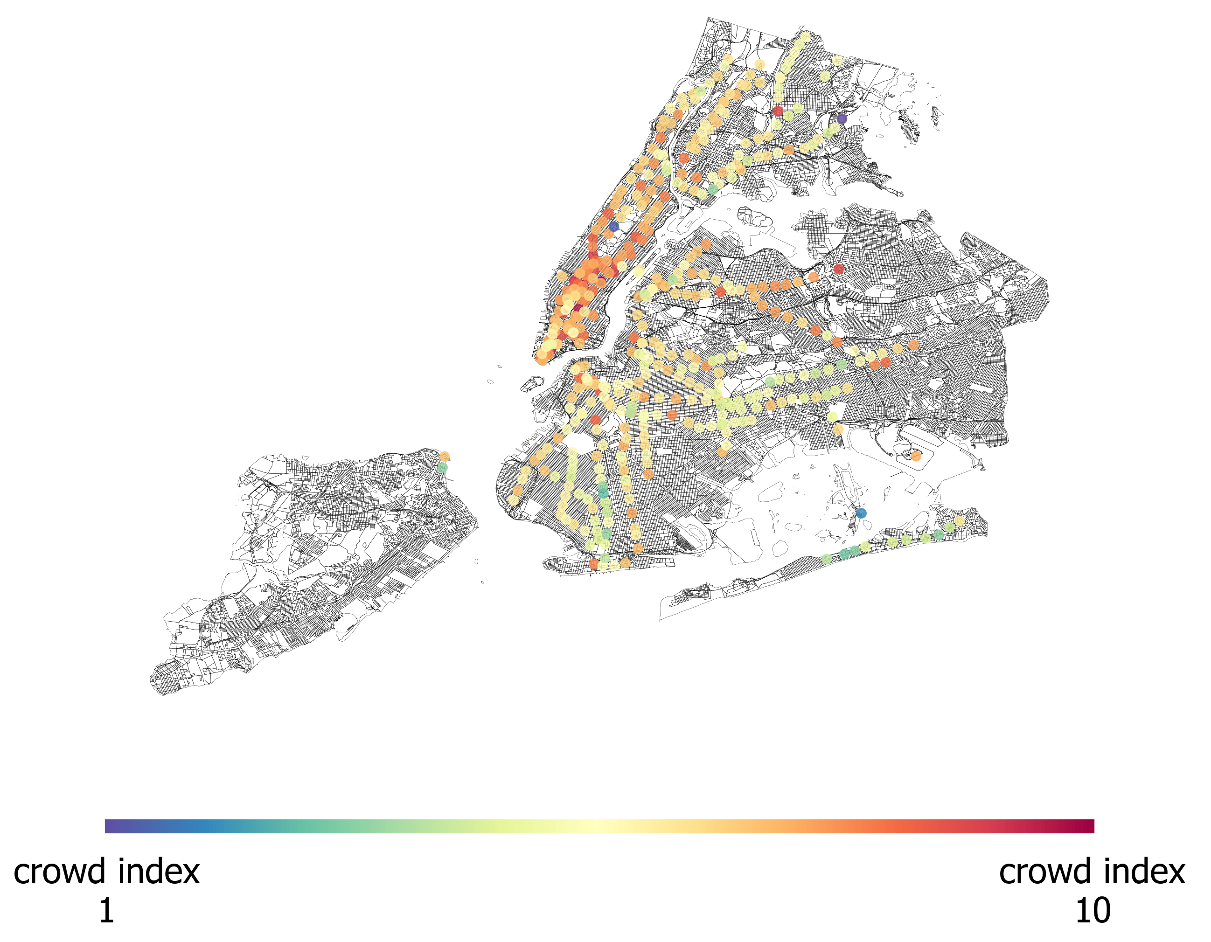
Results: Crowd Index
Based on net entries for each station
Scaled from 1 (fewest entries, bluer colors) to 10 (most entries, redder colors)
Notes:
Now, to our results.
Here we show a map of the MTA stations in the New York City metro area, where each point, each station, is colored by its crowd index, where a crowd index of 10 indicates a very high number of total entries and therefore large crowds.
So that’s our crowd index, now the heat index

Slide 11
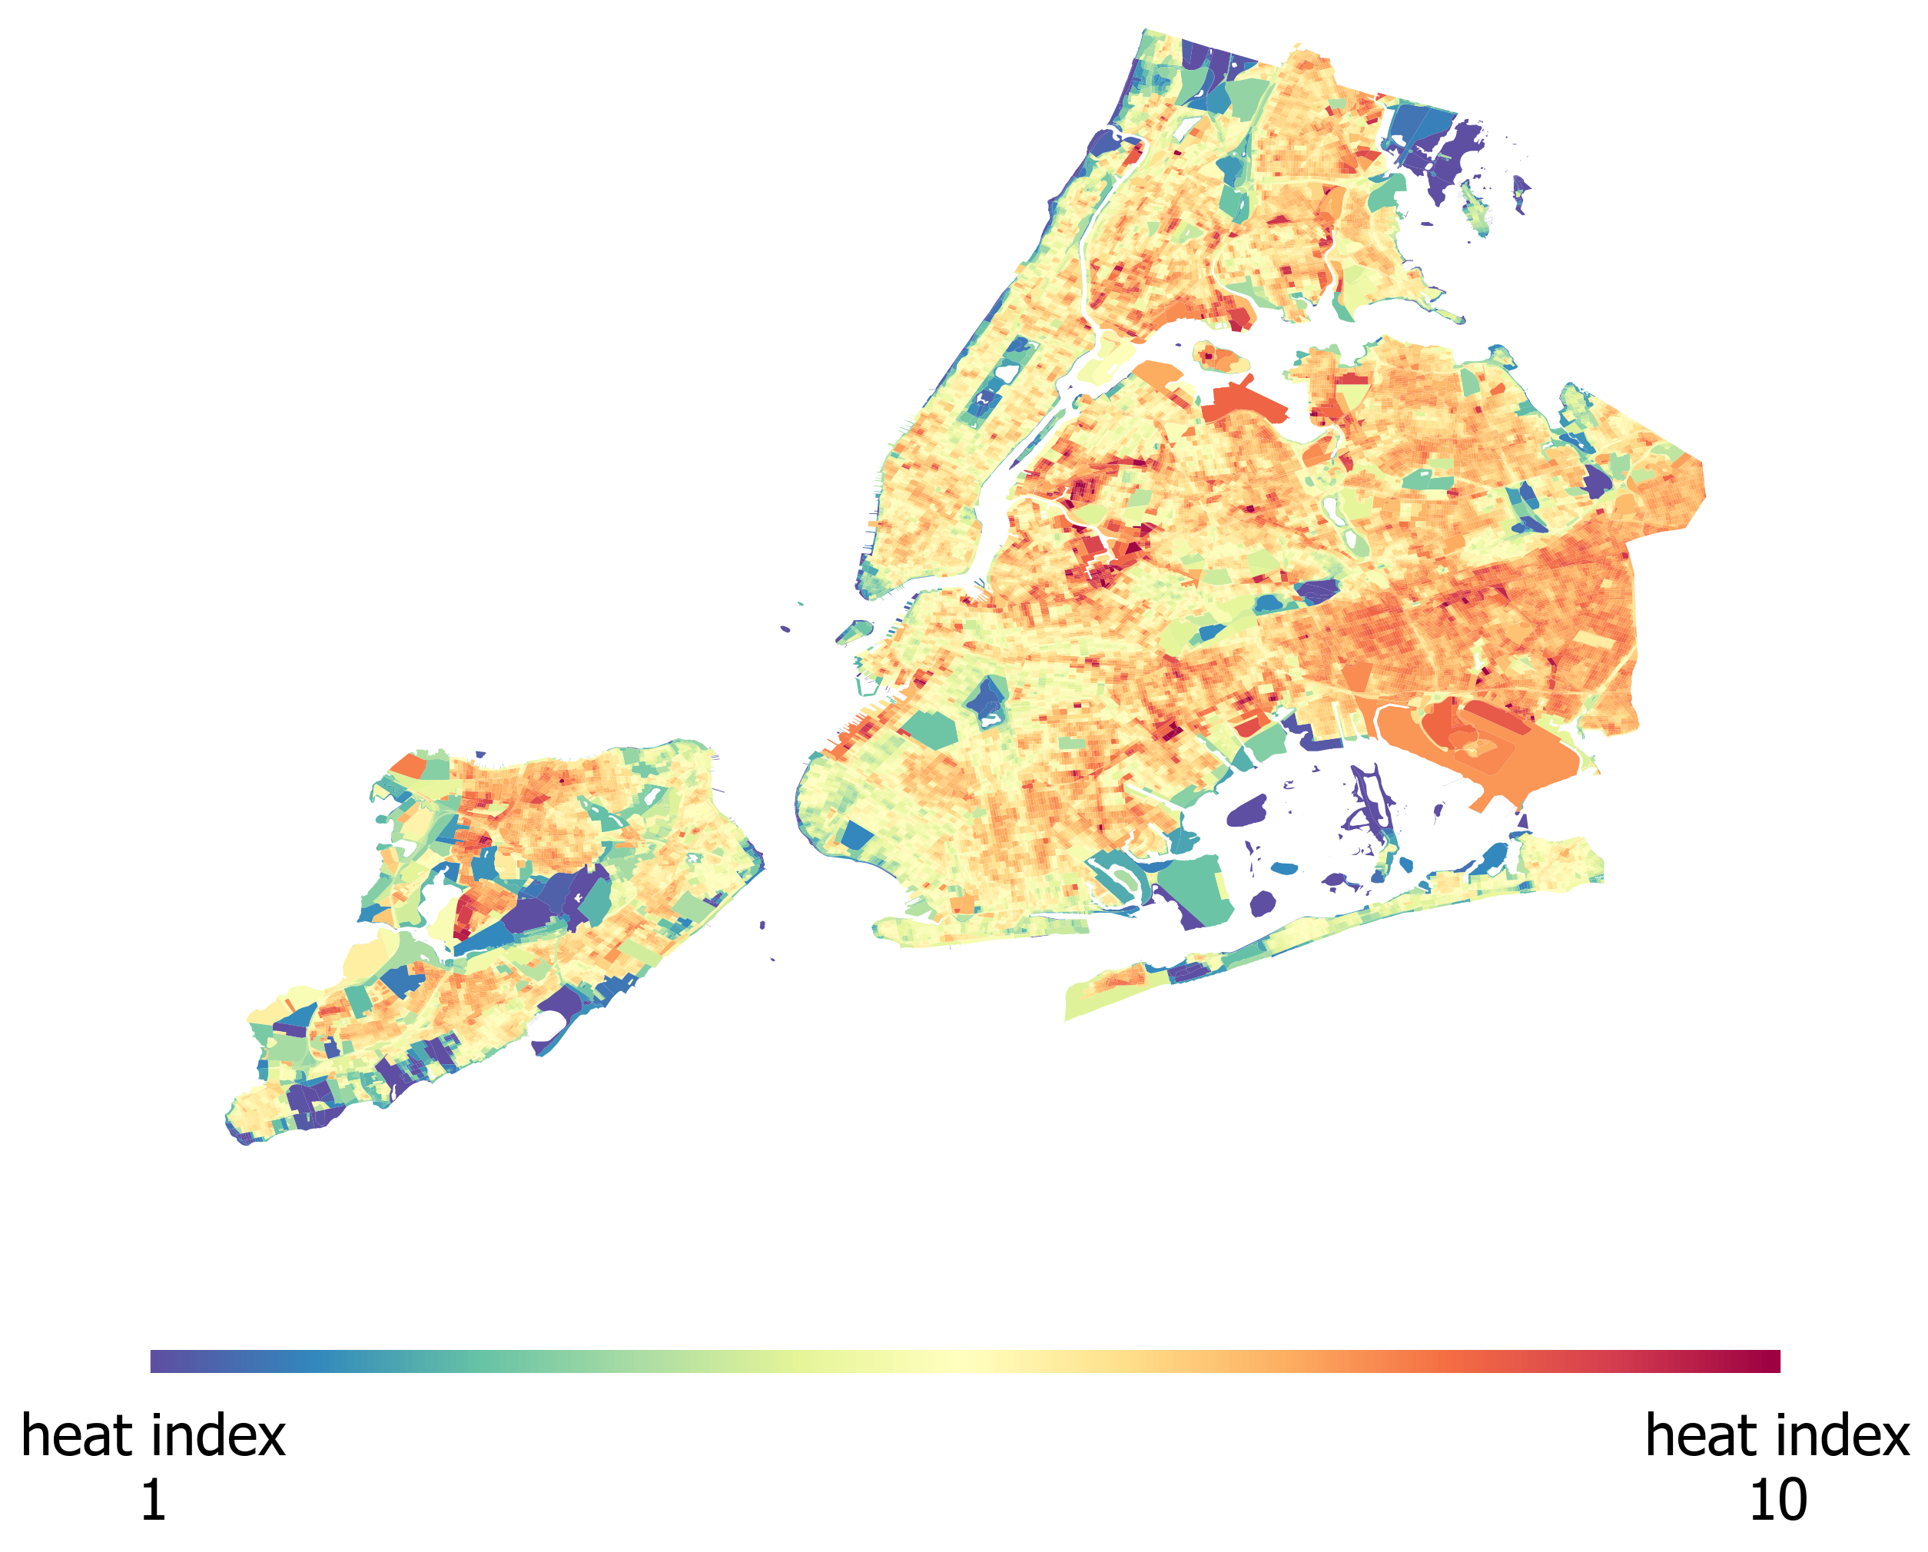
Results: Heat Index
Based on median surface temperature on each city block
Scaled from 1 (lowest temperature entries, bluer colors) to 10 (highest temperature, redder colors)
Central Park
La Guardia
JFK
Latourette Park
Notes:
This map shows the entire land area of New York City, where areas are colored by the heat index, where a higher heat index indicates higher land surface temperatures. And this range of heat indices corresponds to a range in temperature of about 15 degrees F.
Here, it becomes fairly obvious that green spaces and waterfront areas tend to be cooler, while airports and denser city areas tend to be hotter

Slide 12
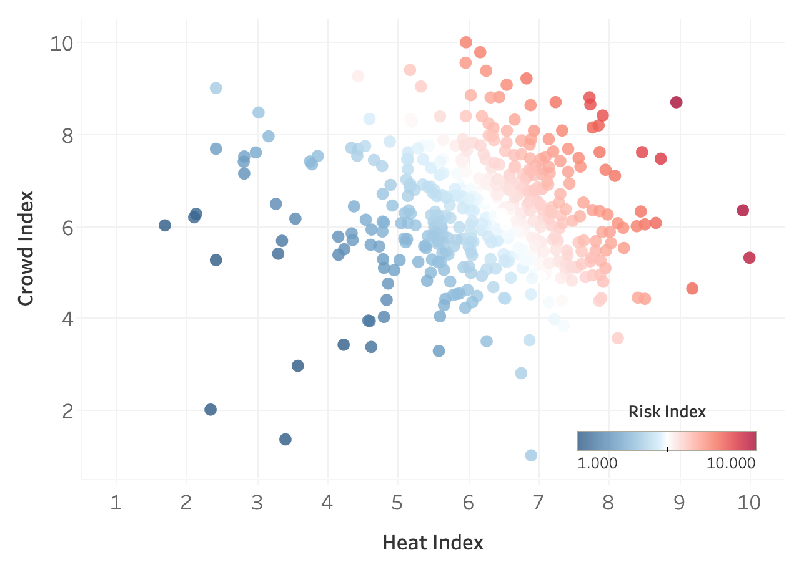
Results: Risk Index
Risk index quantifies heat-illness risk due to combined impact of both heat and crowds
Notes:
By combining those two datasets, we can now create a risk index which incorporates the risk of heat-illness due to both of those factors.
Here, for each station, we show its crowd index versus its heat index, colored by this new risk index.

Slide 13
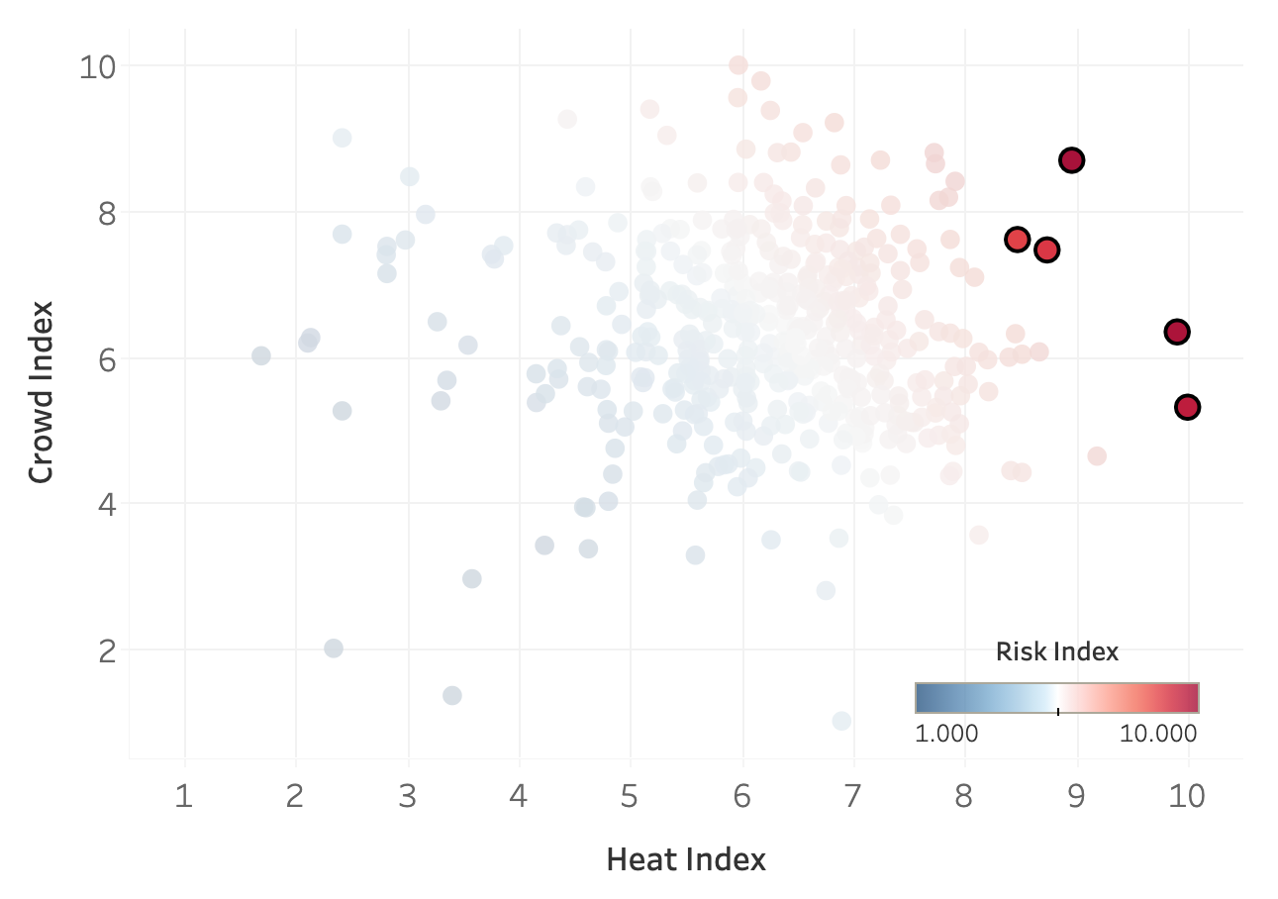
Results: Risk Index
Top 5 risk index stations…
59 ST
KINGSBRIDGE RD
EAST 105 ST
JAMAICA 179 ST
3 AV-149 ST
Are both busy and in hotter parts of the city
High crowd index and high heat index, yields high risk index
Notes:
These are the top five riskiest stations for heat-illness, and, as you can see these stations have both very high heat indices and high crowd indices.

Slide 14
Results: Risk Index
Top 5 risk index stations…
59 ST
KINGSBRIDGE RD
EAST 105 ST
JAMAICA 179 ST
3 AV-149 ST
Are both busy and in hotter parts of the city
High crowd index and high heat index, yields high risk index
e.g., GRD CNTRL-42 ST,
34TH ST-HERALD SQ,
14 ST-UNION SQ
Notes:
Though other stations are busier, particularly some of the biggest Manhattan stations, they are not in the hottest parts of the city, and therefore have lower risk indices.

Slide 15
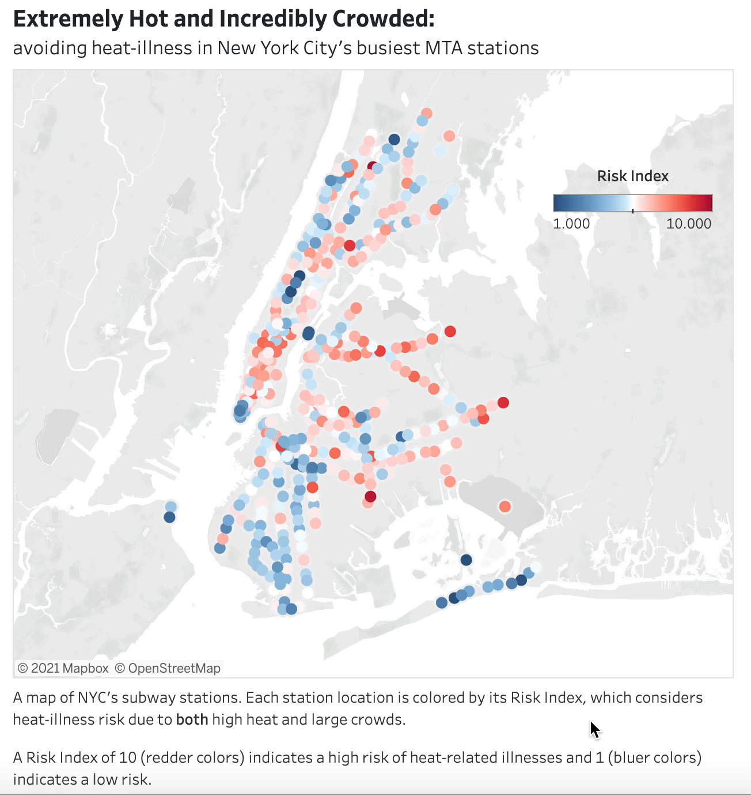

Conclusions: Public Risk Index Station Map
https://bit.ly/mta-heat-eda
SCAN WITH YOUR SMARTPHONE CAMERA
Notes:
Now to make this analysis useful and accessible to the public, we’ve created an interactive Tableau dashboard, which you can access at this link or by scanning this QR code, so that any MTA transit user can explore stations that are nearby the ones they usually frequent, and possibly chose another station that poses a lesser risk for heat-related illnesses.

Slide 16
Conclusions: Public Risk Index Station Map
Top 5 risk index stations: 59 ST, KINGSBRIDGE RD, EAST 105 ST, JAMAICA 179 ST, 3 AV-149 ST
Many of these high-risk stations have lower-risk stations that are nearby, and service the same lines
Notes:
So to conclude, here we list again the five riskiest stations for heat illness, and add that many of these high risk stations have lower-risk stations nearby that service some of the same lines. Those nearby stations might provide better options for people at high risk for heat related illnesses.

Slide 17
Future Work
Provide alternate nearby, low-risk stations for each line at a high-risk station
Expand heat analysis to include New Jersey so that more PATH stations can be included
Notes:
And finally, some future directions
We’d like to provide alternate, nearby, low-risk stations for each line serviced at high-risk stations.
And we’d like to expand our surface temperature analysis to include New Jersey, so that stations in that area can be added to these results

Slide 18
Questions?
SCAN WITH YOUR SMARTPHONE CAMERA
Notes:
And so with that, I can take questions

Slide 20
59 ST (lines 456NQRW) → RIT MANHATTAN (line R)
KINGSBRIDGE RD (line 4) → FORDHAM RD (line 4)
EAST 105 ST → no low-risk station serving the same lines within 0.75 miles
JAMAICA 179 ST → no low-risk station serving the same lines within 0.75 miles
3 AV-149 ST (lines 25) → JACKSON AV (lines 25)

Slide 21


Slide 22
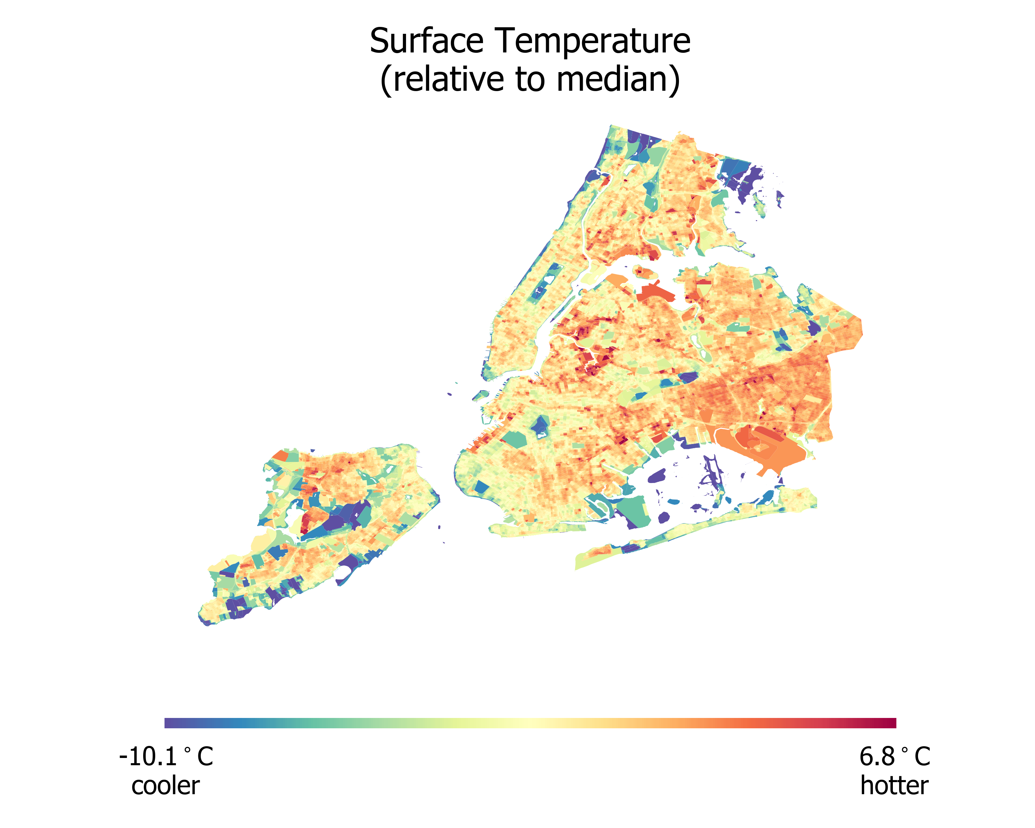

Slide 23
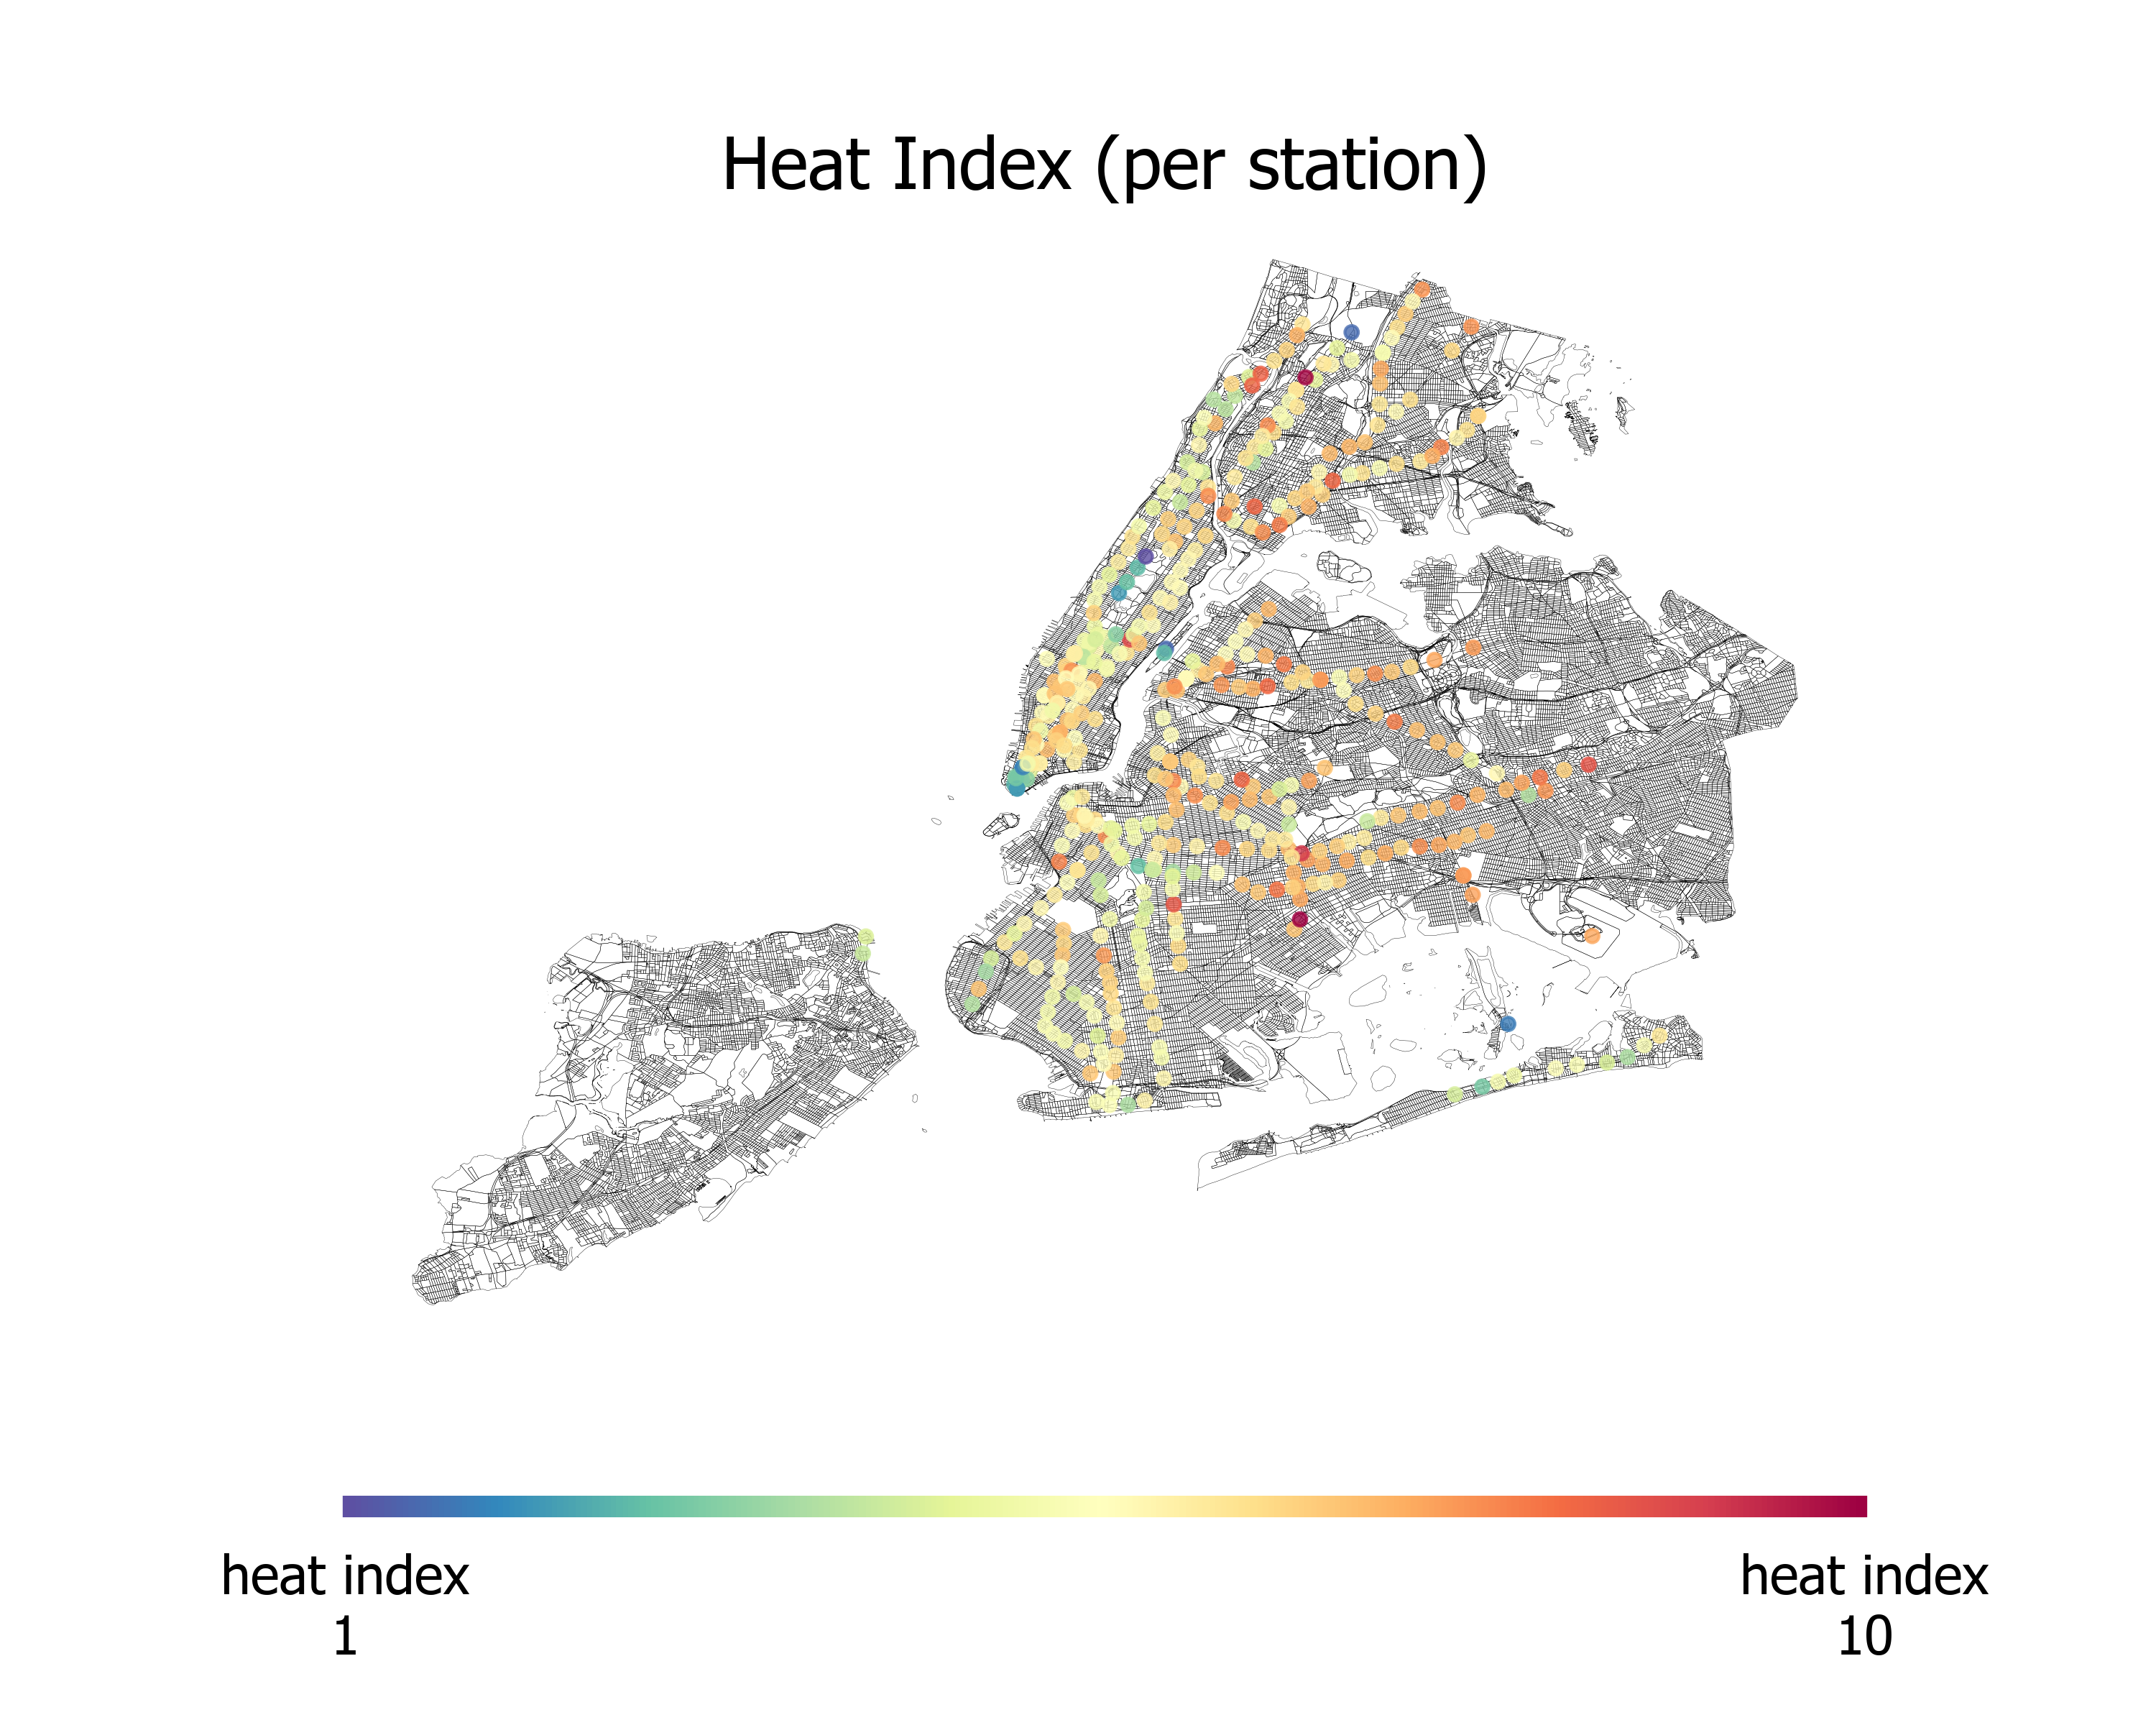

Slide 24
